Slide 1





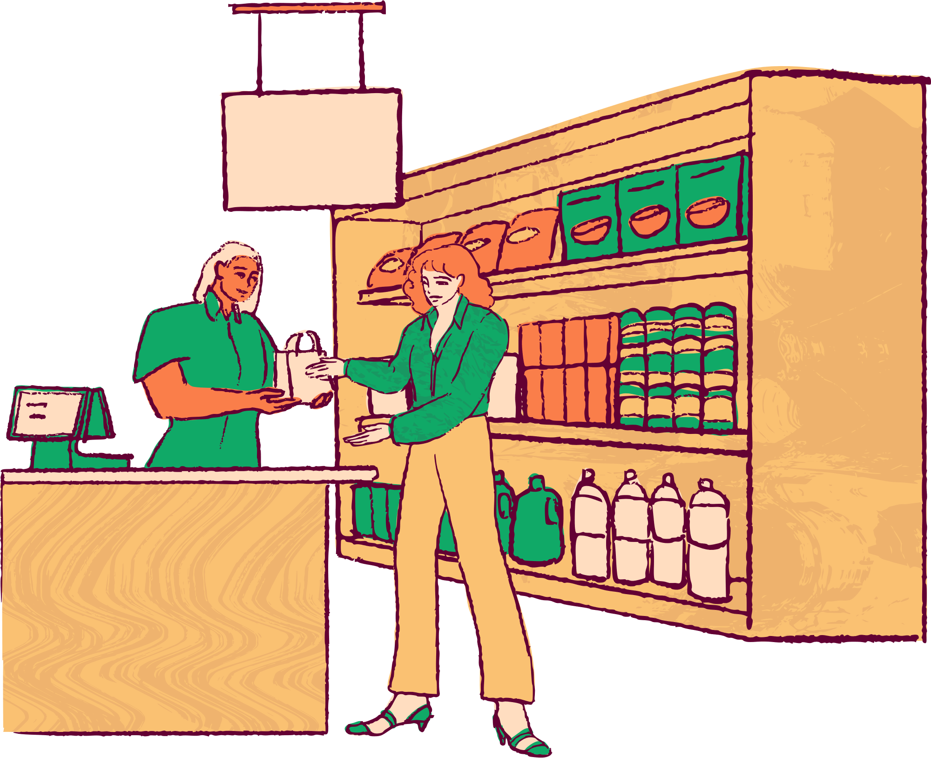
Team TensionFlow - Team 127
CyberCipher3.0 - Advanced PS
Green Basket
Nourishing Families, One Click at a Time
Abhay Mathur
Shreya Shah
Devansh Rathor

Slide 2
Problem Statement
The problem statement for the project is to address the challenges faced by Aryan, the owner of a family-owned grocery store in Mumbai. The issues include poor inventory management and untimely food orders, which have resulted in a decline in business and financial difficulties. Aryan seeks a solution from fetch.ai, involving the utilization of uAgents and the development of a deep learning model to improve the efficiency and sustainability of his grocery store.

Slide 3
Our Features
Automated Inventory Management System
Order Management for Deliveries
Inventory Depletion Alert for Restocking
Demand Forecasting using LSTM
Delivery Agent Management and Tracking
Real Time Analysis for Categories of Sold Items
Checking Availability via Images using CNN

Slide 4
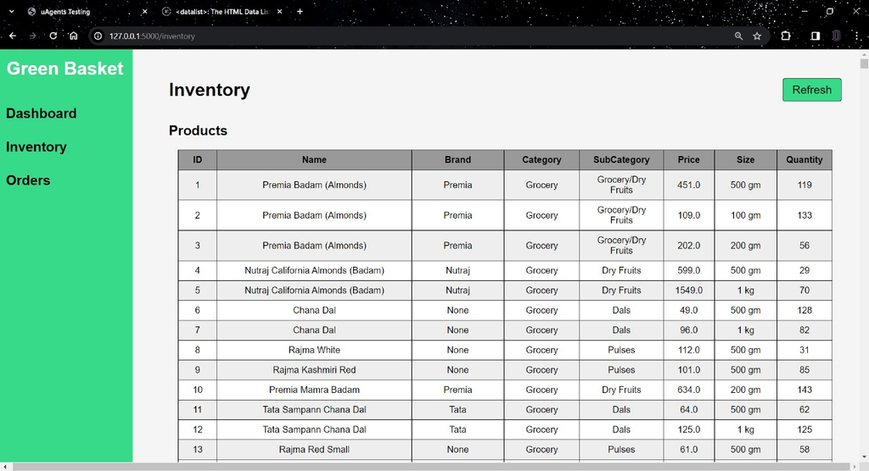
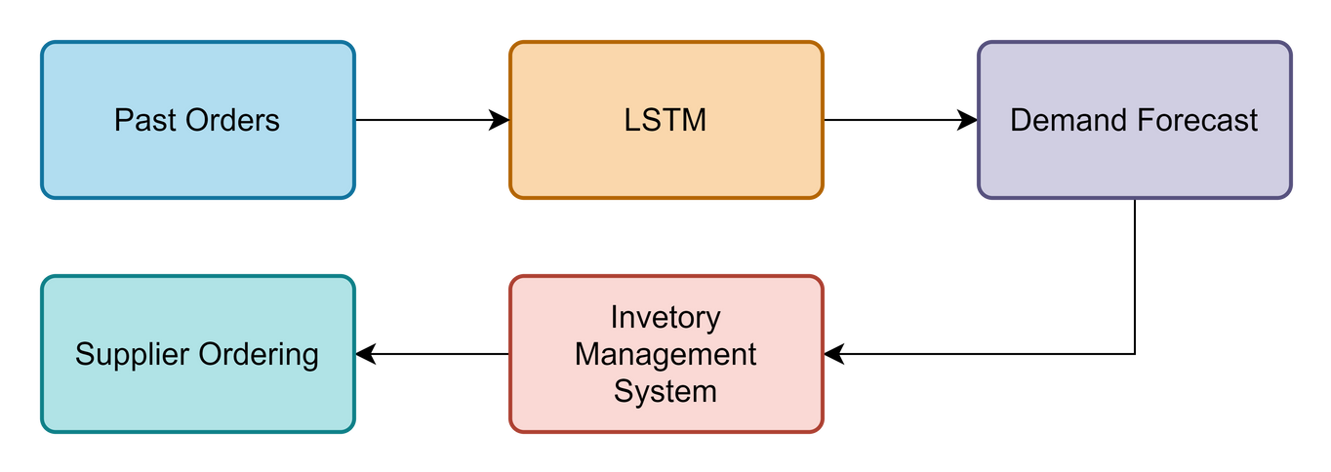
How it works
Automated System for logging, updating and deleting from inventory
Using Long Short Term Memory (LSTM) model for time-series analysis, predicting inventory required for a particular month for a product so the store can restock and therefore ensure timely order of stock

Slide 5
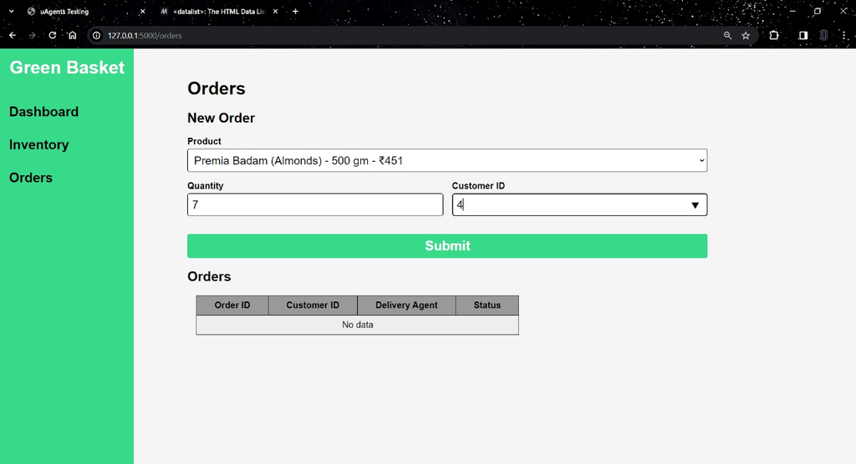
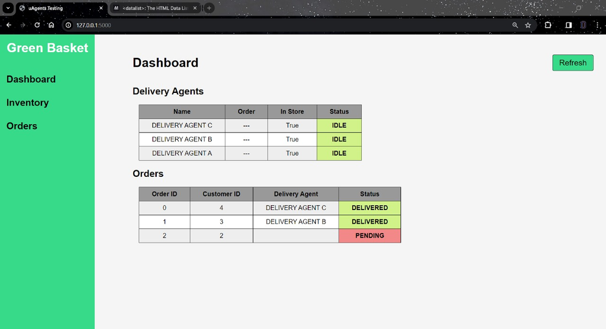
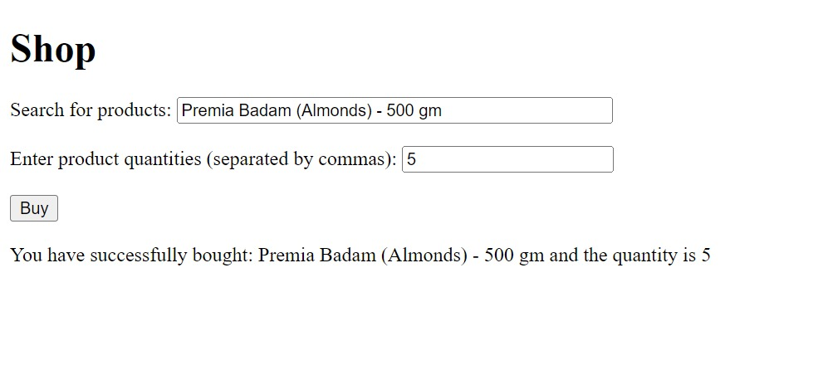
How it works
Receiving delivery orders from customers through an Input Agent,which sends a message to Database Agent which is used for checking for avalilability and making the required deduction in available stock
The Alert Agent prints an alert message when the available quantity of a product is below a certain threshold and the required restock quantity
The Manager Agent sends a ready message and then checks for one of the Delivery Agents that is currently free to dispatch an order

Slide 6
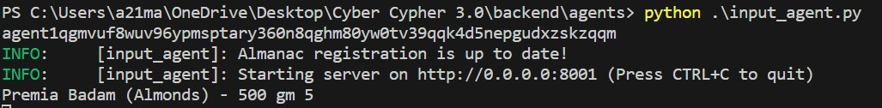
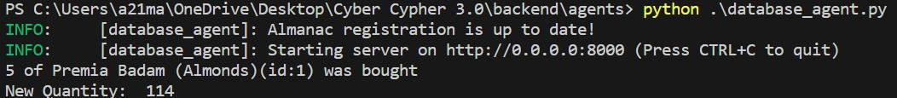
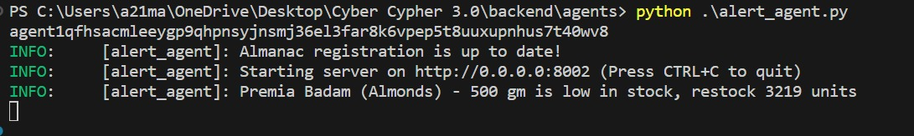
Input Agent:
Database Agent:
Alert Agent:

Slide 7
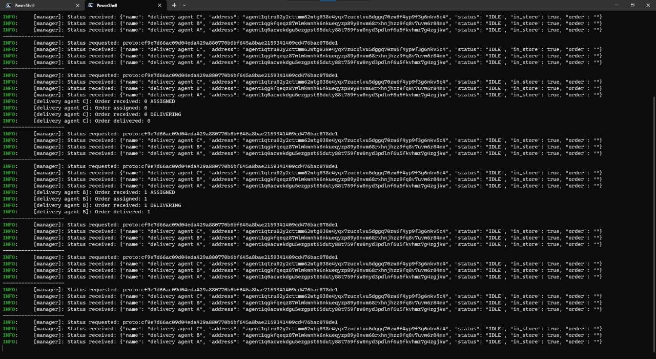
Manager and Delivery Agents:

Slide 8
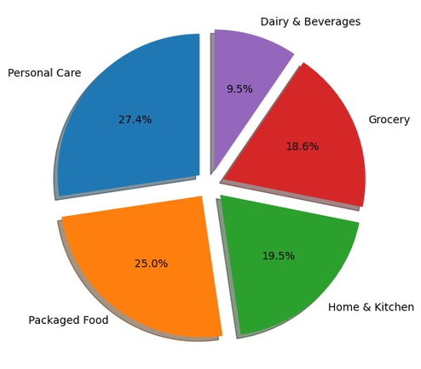
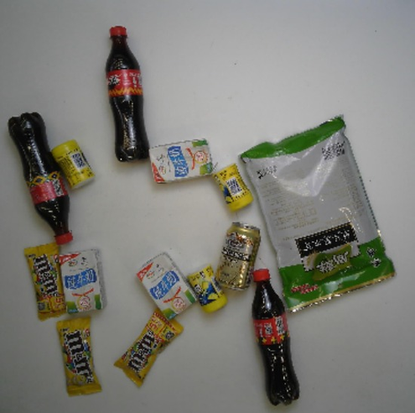
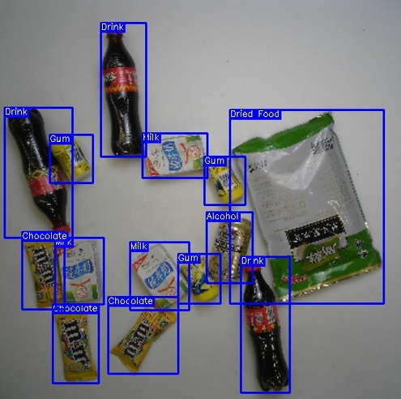
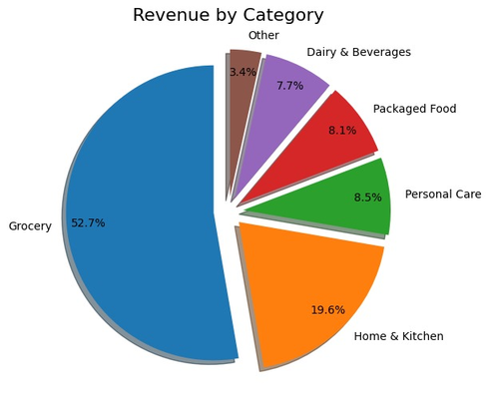

How it works
Real time analysis of categories sold in the day
Using a Convolutional Neural Network (CNN) model to visually detect available stock to help with alerts for restocking

Slide 9
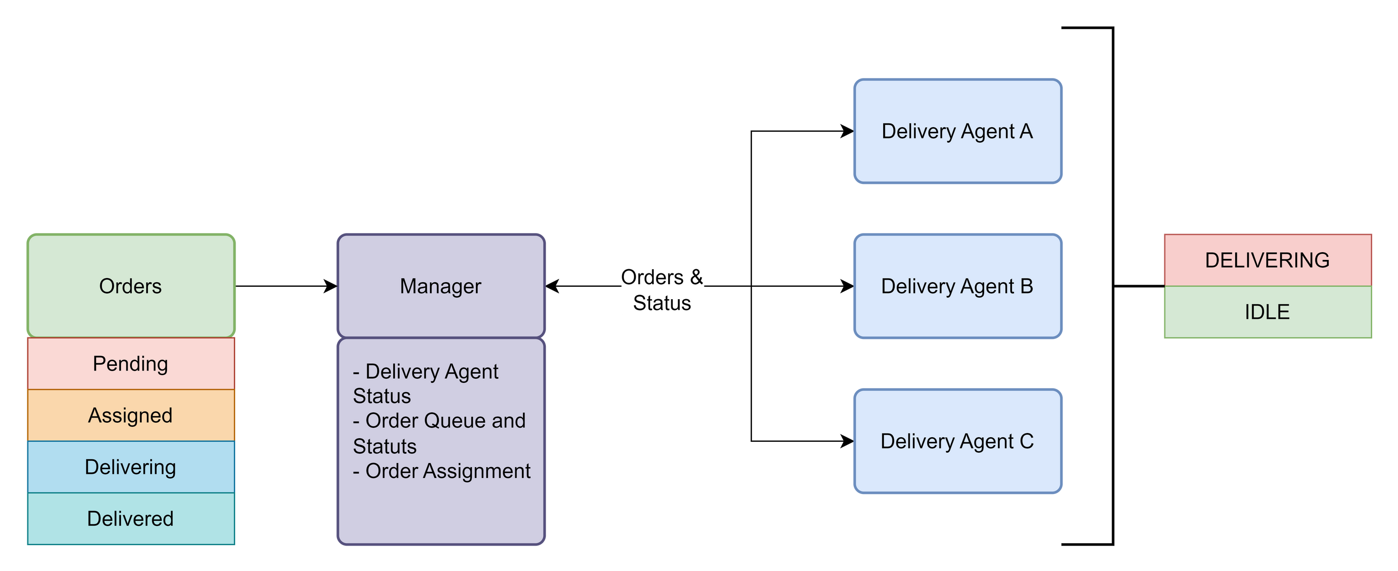
Flow of Customer Orders

Slide 10



01.
02.
Real-time Route Optimization for delivery agents for fastest possible deliveries and tracking their real time location
Seamless Payment Gateway Integration on the customer side to make online payements for their grocery delivery order.
Future
Scope
03.
04.
Market Basket Analysis from order data for Personalised Promotions & Offers Management
Automated ordering of stocks from multiple suppliers to optimize cost, time and availability

Slide 11
Team TensionFlow - Team 127
Thank you very much!

